Slide 1
Refraction Migration
Isa Eren Yildirim Dias Urozayev
King Abdullah University of Science and Technology
10/12/2015

Slide 2
Outline:
Diffraction Stack migration
Least Squares Migration
Implementations
Results and Discussions
Conclusion

Slide 3
Outline:
Diffraction Stack migration
Least Squares Migration
Implementations
Results and Discussions
Conclusion

Slide 4

Diffraction Stack Migration
d – weighted second-time derivative of the observed traces
x_{s} - source location
x_{g} - geophone location
t_{sx}+t_{xg} – minimum traveltime

Slide 5
Outline:
Diffraction Stack migration
Least Squares Migration
Implementations
Results and Discussions
Conclusion

Slide 6





Least Squares Migration
Forward modeling
Migration
Objective function
Misfit gradient
SD solution

Slide 7
Outline:
Diffraction Stack migration
Least Squares Migration
Implementations
Results and Discussions

Slide 8
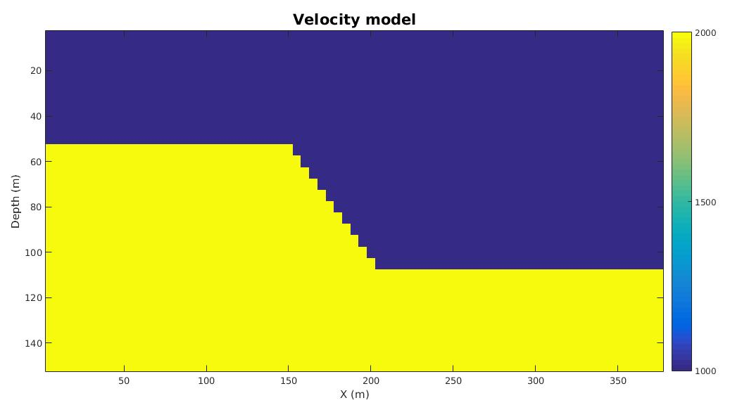
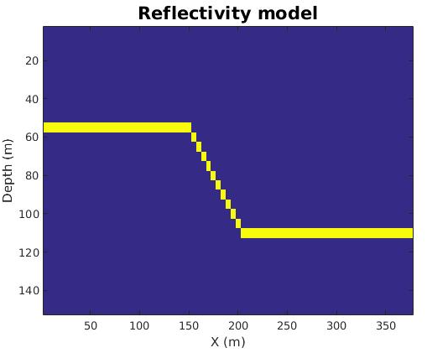
Implementation
m/s

Slide 9
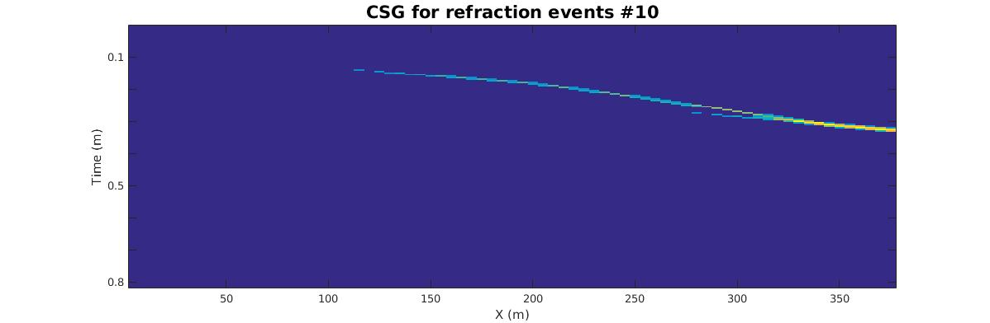
Implementation

Slide 10
Outline:
Diffraction Stack migration
Least Squares Migration
Implementations
Results and Discussions
Conclusion

Slide 11
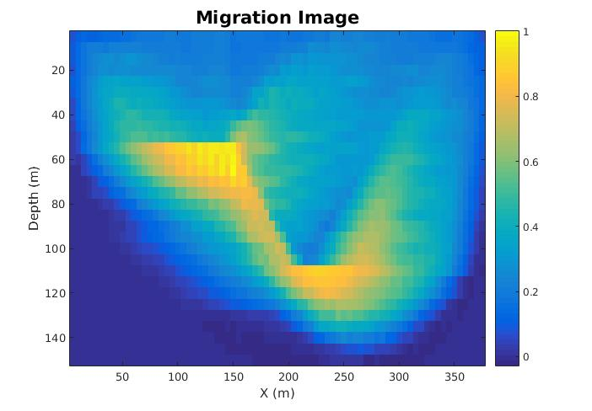
Results and Discussion

Slide 12
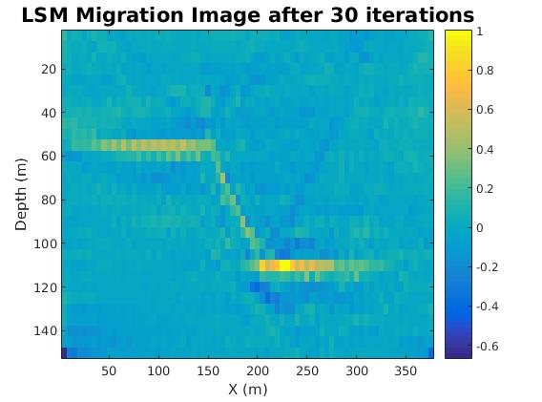
Results and Discussion

Slide 13
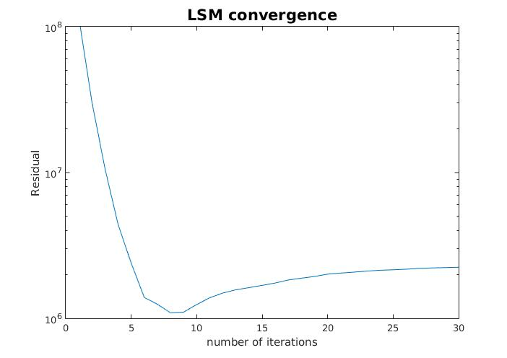
Results and Discussion

Slide 14
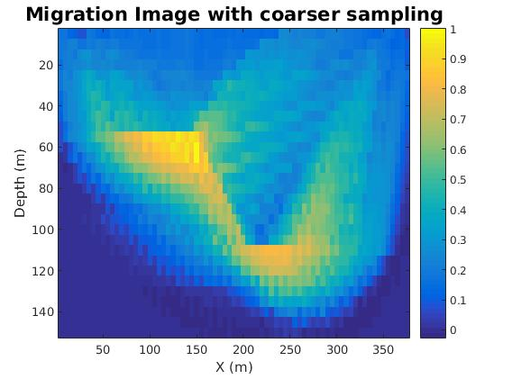
Results and Discussion

Slide 15
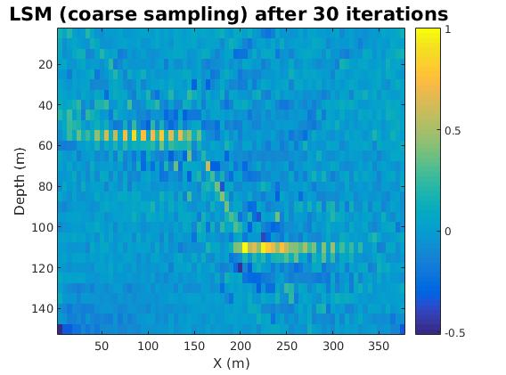
Results and Discussion

Slide 16
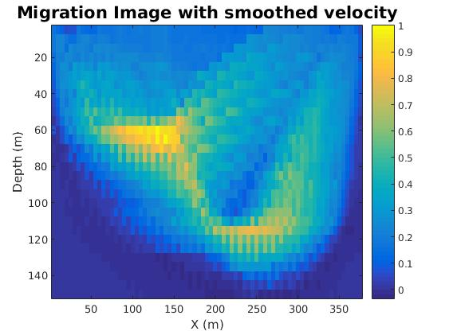
Results and Discussion

Slide 17
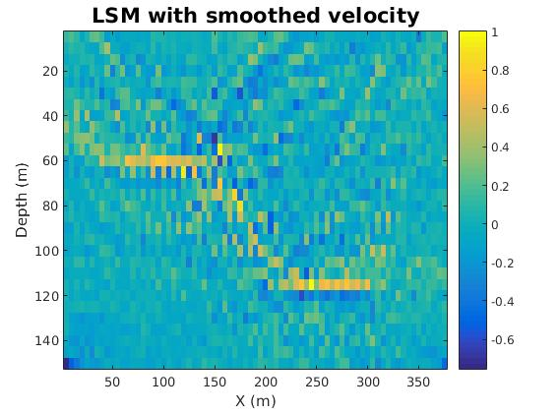
Results and Discussion

Slide 18
Conclusion
Synthetic Case was tested to migrate the image
Smoothing migration velocity improves resolution
LSM applied and showed improvement in the resolution
LSM improves the image while loosing spatial sampling resolution

Slide 19
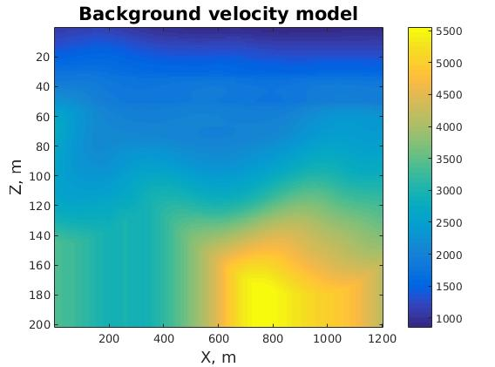
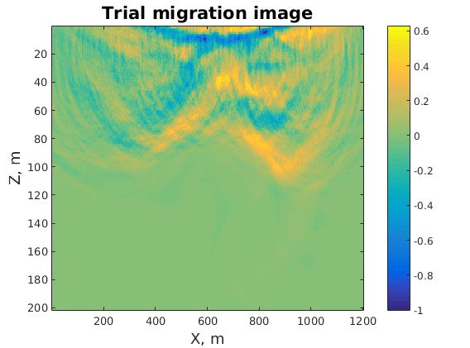
Future work: Olduvai data

